Slide 1
COFSP Culmination Presentation
Jacob Knorr – COFSP Recipient
Senior in Biomedical Engineering
Scott High School – 10th grade Biology

Slide 2
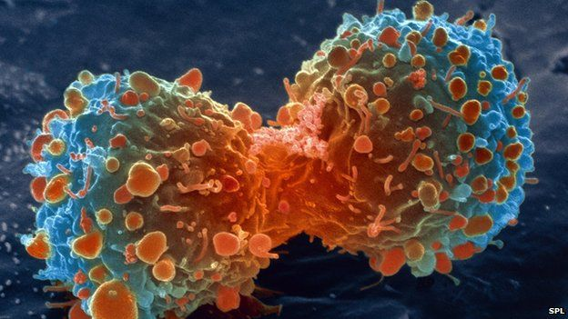
Unit Overview
Topic:
The Cell Cycle, Mitosis, and Cancer
Standards:
NGSS HS-LS1-4 --From Molecules to Organisms: Structures and Processes. Use a model to illustrate the role of cellular division and differentiation in producing and maintaining complex organisms.

Slide 3
The Minimally Invasive Challenge
Activity Highlights
Learning Objectives
Describe how cancer develops and affects body function.
Identify three types of cancer and risks for developing cancer
Describe the issues associated with treating a tumor surgically
Design a device to remove a tumor (jelly bean) from the body (Jell-O) with the least damage.
Predict how the device will work in the body.
Record observations on the performance of the device.
Critique other student devices and defend their own device.
Propose improvements to their device for improved function.
Guiding Questions
Why does cancer form in the body? How does it affect function?
What features does the device need to remove the tumor?
What are some issues with treating a tumor surgically?
How will the device affect the surrounding tissue in the body?
How did your device perform? How big was the incision?
How did others’ devices compare to your own?
What improvements could device use? How would you do it?

Slide 4
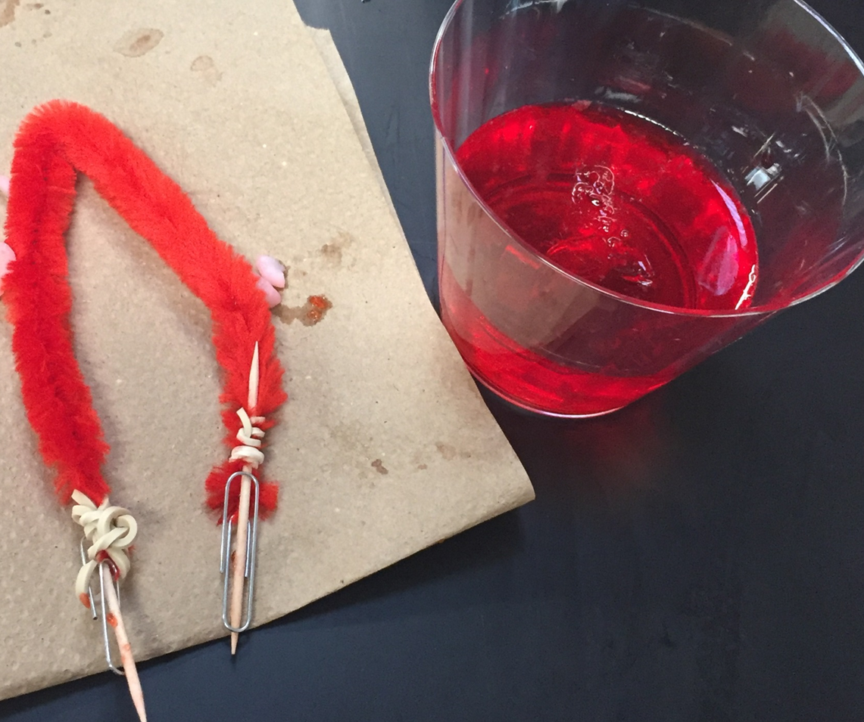
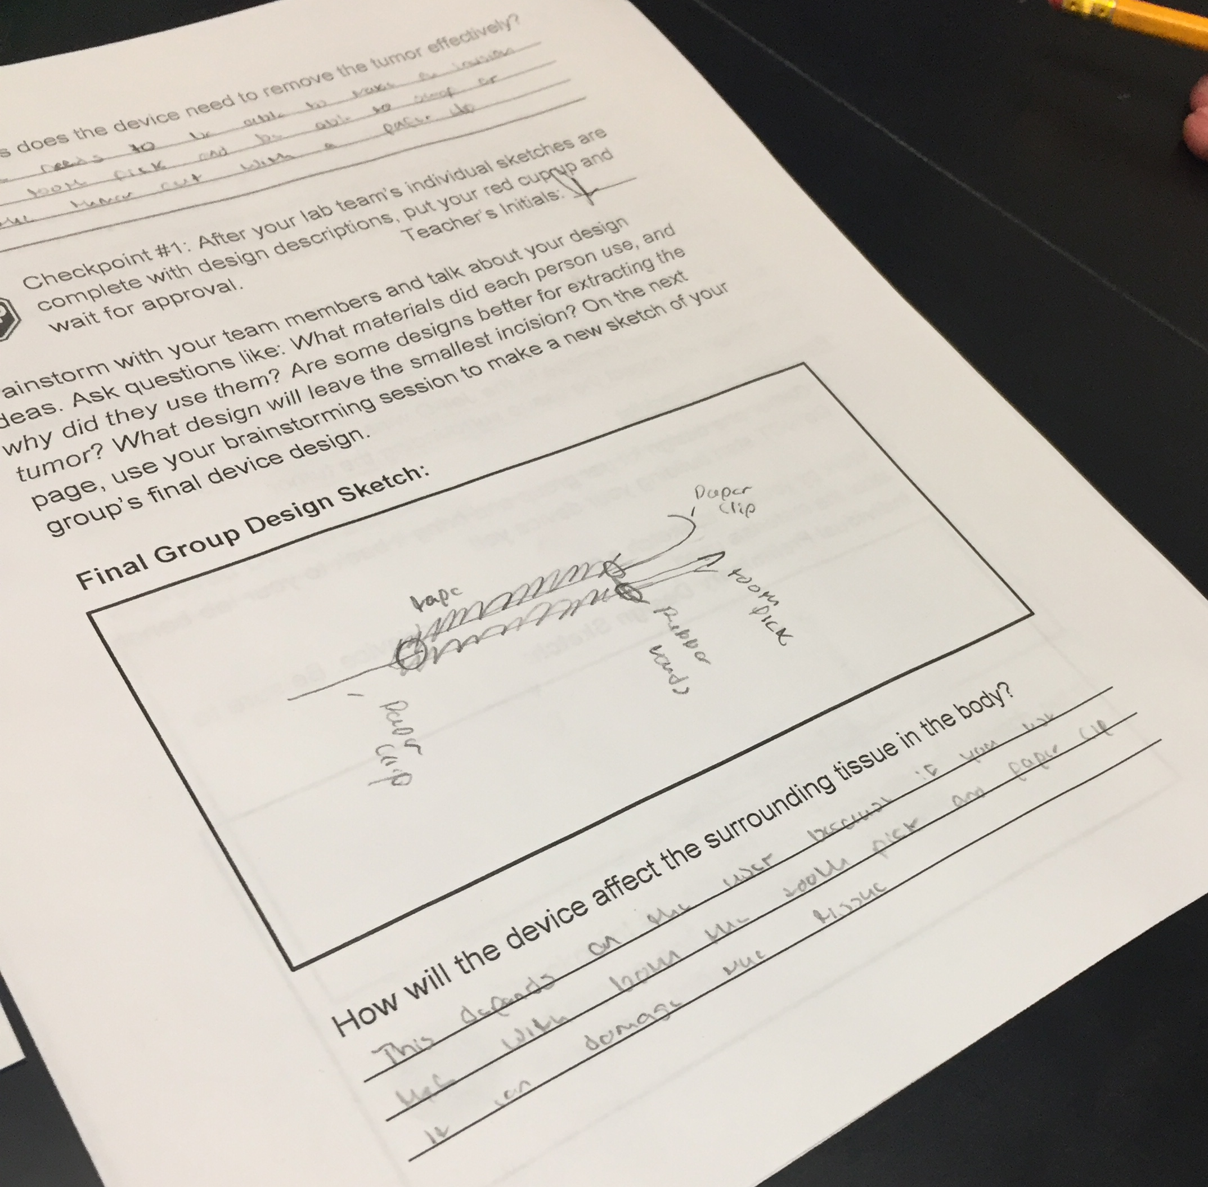
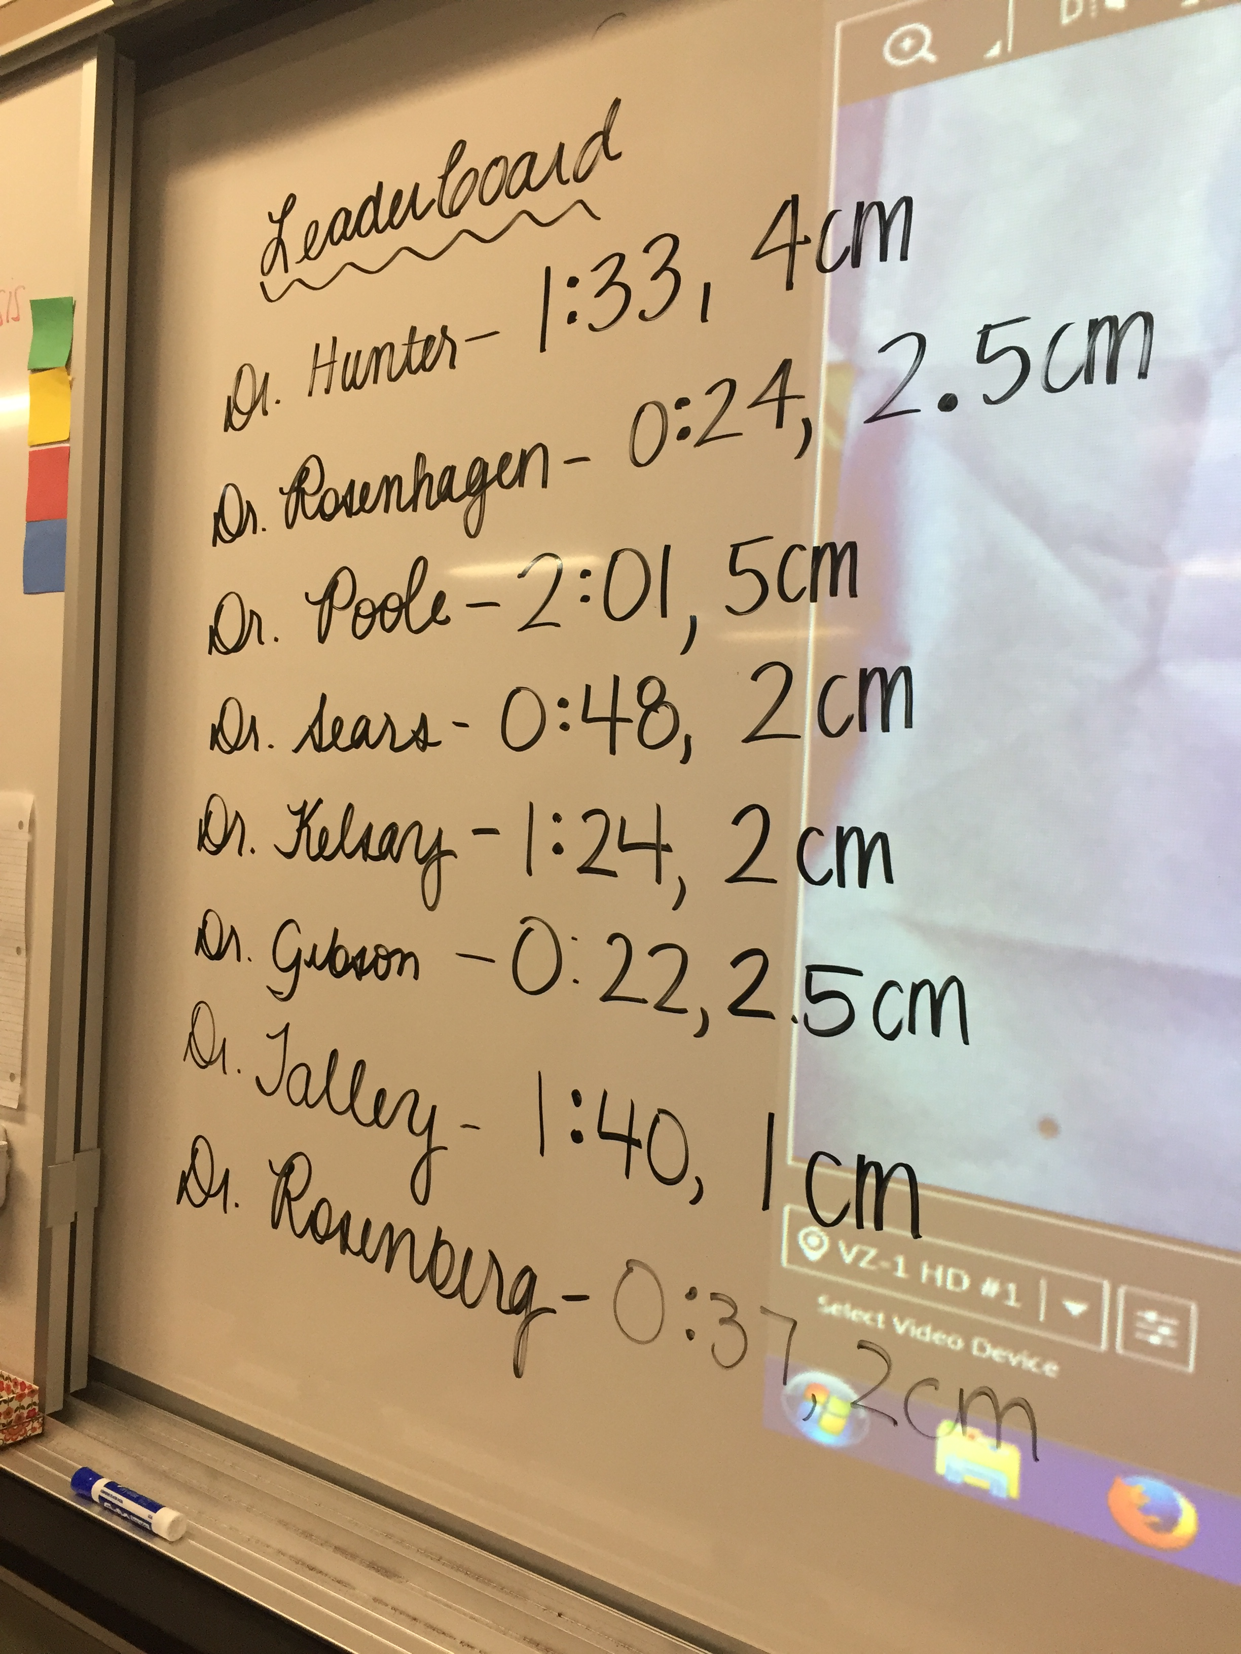
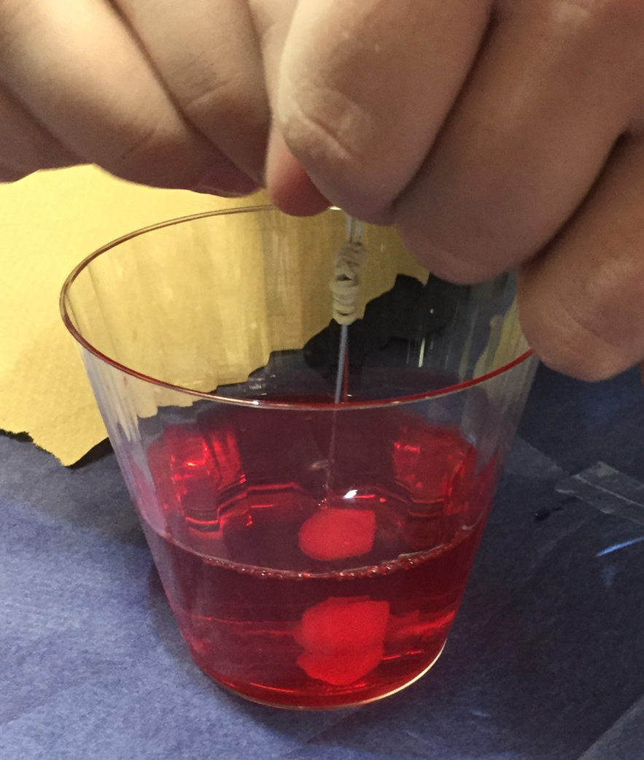
Activity Highlights

Slide 5
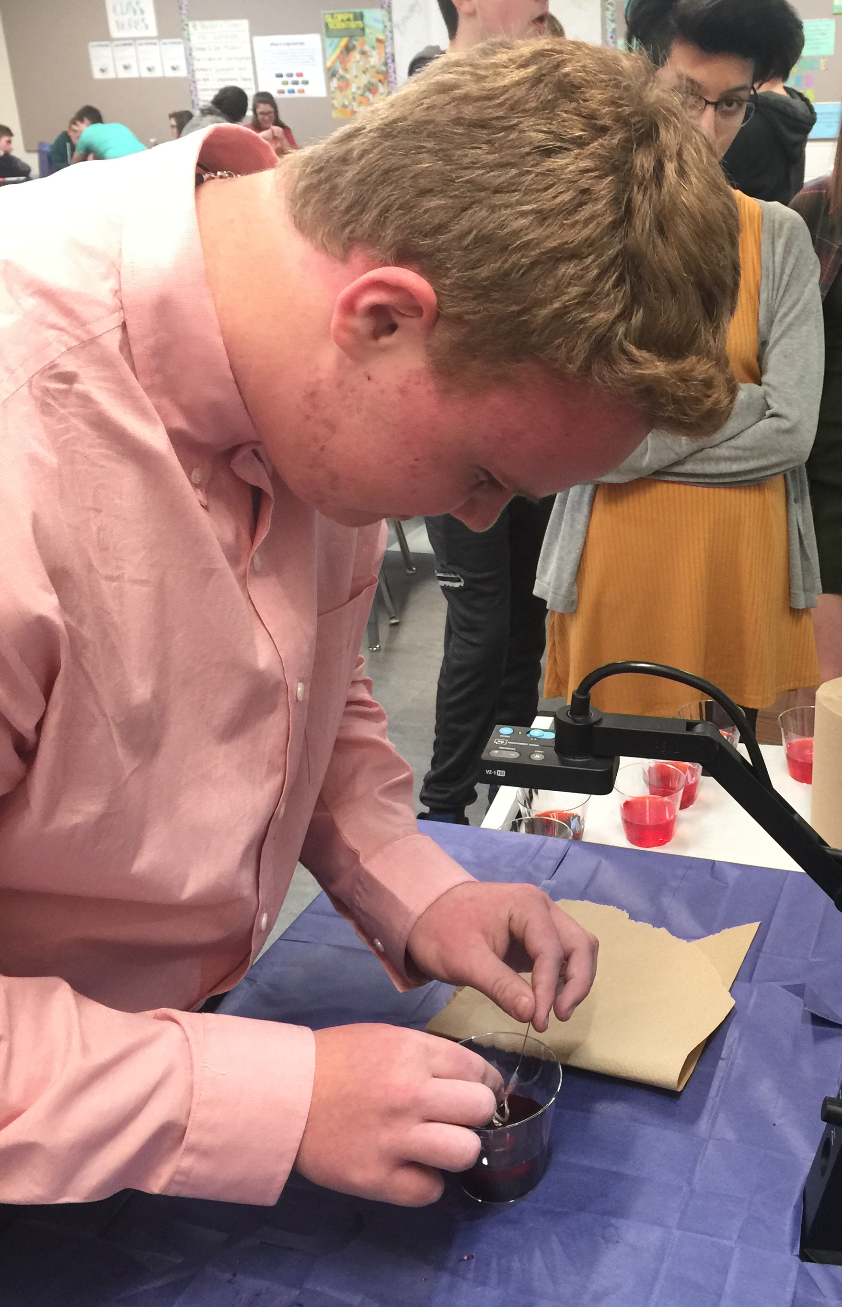
Application, Career, Society
Application to real world surgery that addressed problems with the surgical treatment of tumors
A hands-on introduction to careers in engineering, medicine, and healthcare
EDP can limit cost and make healthcare more efficient

Slide 6
Evidence of Student Learning

Slide 7
Reflection
Overall success with great class involvement
With directed guidance, slower groups still achieved success
Exposed students to the engineering design process through a fun competition that got everyone involved.

